Slide 1
Digital Forensics Lecture-1
By- Dr.subhranil Das
Assistant Professor
School of computer Science

Slide 2

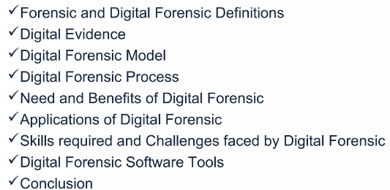
Contents

Slide 3
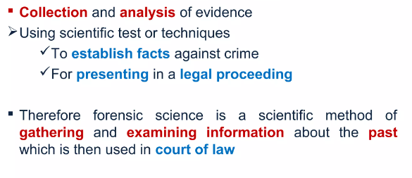
What do you mean by digital forensics?

Slide 4
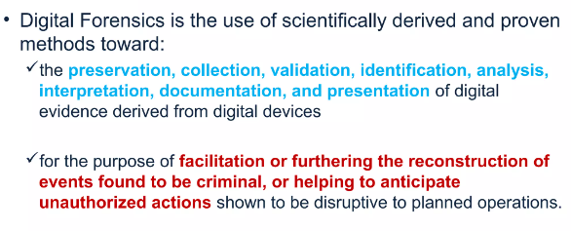
Digital forensics

Slide 5
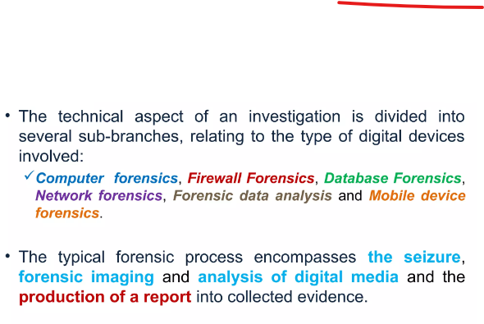
Branches of Digital Forensics

Slide 6
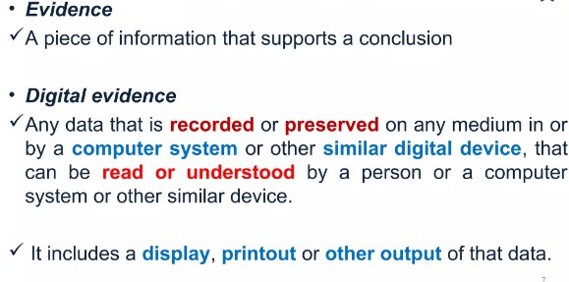
Evidence

Slide 7
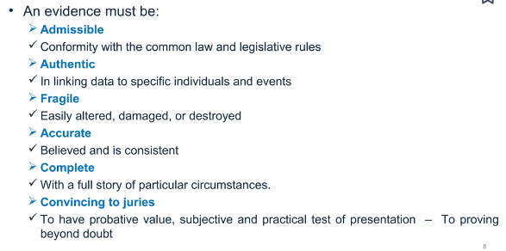
Characteristics of Evidence

Slide 8
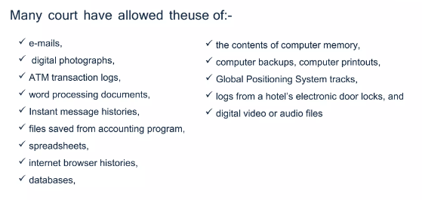
Examples of digital evidence

Slide 9
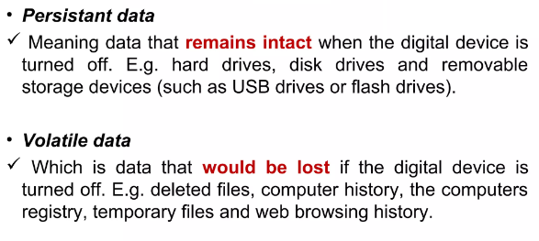
Types of digital evidence

Slide 10
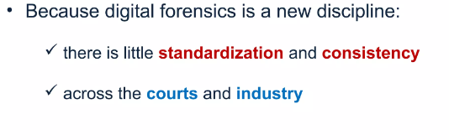
Digital Forensic Model

Slide 11
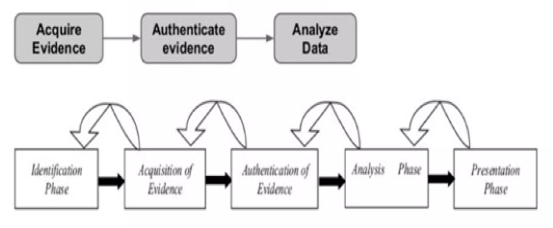
Basic Digital Forensic Model

Slide 12
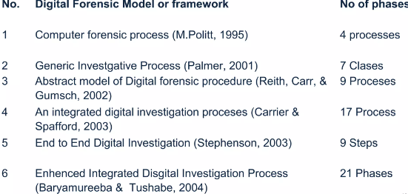
Different Models of Forensic Models

Slide 13
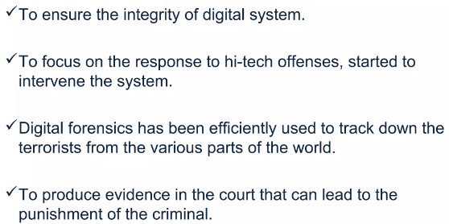
Need for Digital Forensics

Slide 14
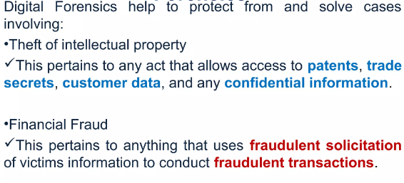
Application of Digital Forensics

Slide 15
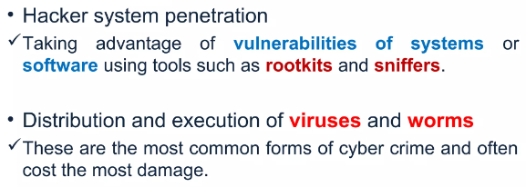
Application of Digital Forensics

Slide 16
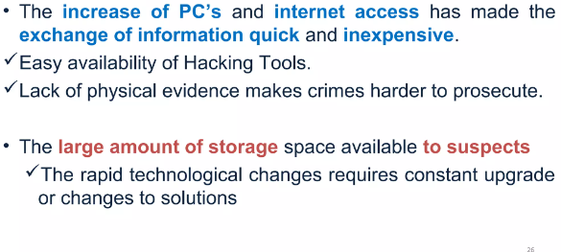
Challenges faced by Digital Forensics

Slide 17
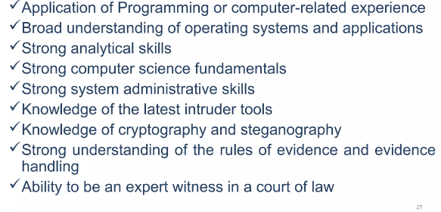
Skills for Digital Forensics

Slide 18
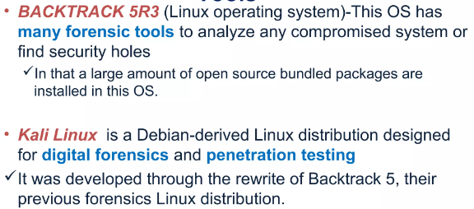
Tools for Digital Forensics

Slide 19
Fundamental concepts and principles of digital forensics
Next Lecture

